Slide 1

Law of Large Numbers
EDUC 641: Week 3
Cengiz Zopluoglu

Slide 2
Goals
Understand the concept and properties of the Normal Distribution
Learn how mean (μ) and standard deviation (σ) define its shape Interpret areas under the normal curve using PDF and CDF
Learn to use R functions (dnorm, pnorm, qnorm) for working with normal distributions
Compute probabilities and quantiles Visualize and interpret normal curves
Apply the Empirical Rule to real-world contexts Understand the Sampling Distribution
Conceptualize sampling distributions as distributions of sample statistics Use simulations to explore variability across samples
-Understand the Central Limit Theorem (CLT)*
See how sampling distributions approach normality as sample size increases Connect CLT to statistical inference and hypothesis testing

Slide 3
Introduction to Normal Distribution

Slide 4
What is a statistical distribution?
A nontechnical definition
A statistical distribution is a tool that we use to describe how numbers tend to show up in the world.
A more technical definition
A statistical distribution is a mathematical function that assigns probabilities to the possible values of a random variable, describing how frequently each value (or range of values) occurs.
They help us talk about what’s typical, what’s unlikely, and how often different outcomes might occur.
A chart of univariate distributions

Slide 5
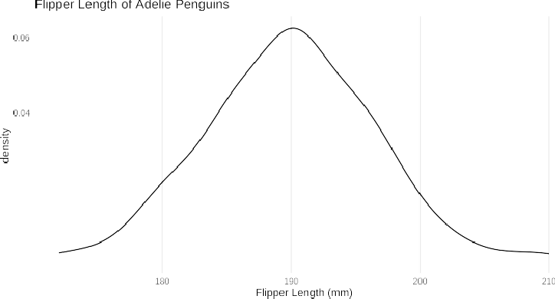
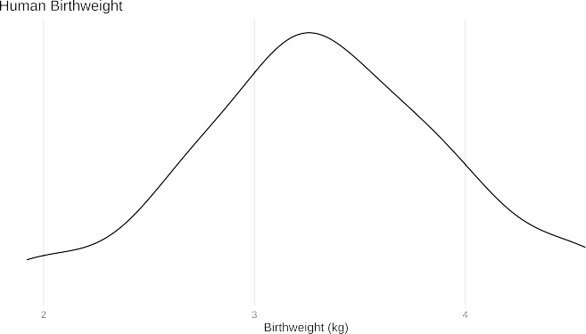
Normal Distribution (Gaussian Distribution)
Origins: modeling measurement error in astronomy, (for more -> Evolution of Normal Distribution)
A number of real-world phenomena follow an approximately normal distribution
It connects the randomness of the real world with a mathematical structure
Its symmetry around the mean simplifies a lot of things
Plays a central role in classical statistical inference (hypothesis testing)

Slide 6
Definition & Notation
A normal random variable is written
X ∼ N (μ, σ)
where:
μ represents the mean parameter (location), and
σ represents the standard deviation parameter (scale)
Every continuous distribution is defined by a probability density function (PDF) that determines its shape.
f(x) =
1
e
₋ (x−μ)²
σ√2π
2σ²
x is the real-valued input value for the function
π (3.14...) and e (2.71...) are mathematical constants

Slide 7

f(x = 30) =
1
(30−50)²
−
= 0.0054
e
2∗10²
10 ∗ √2 ∗ 3.14
f(x = 40) =
1
(40−50)²
−
= 0.024
e
2∗10²
10 ∗ √2 ∗ 3.14
The probability of observing values around 40 are more likely than the probability of observing values around 30 because X=40 has a higher density than X
= 30.
For continuous distributions, while they are closely related, the probability and the probability density are not the same thing.
Probability ≠ Density
PDF gives density, not probability.

Slide 8
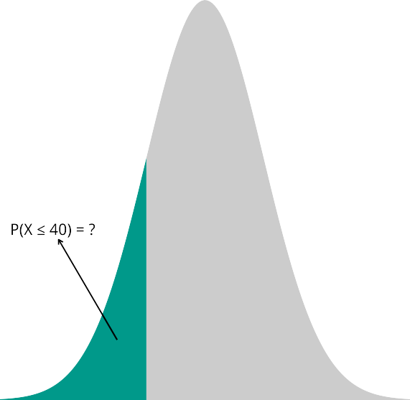

Cumulative Distribution Function (CDF)
When working with continuous distributions, it doesn’t make sense to talk about the probability of a single exact value as it is literally zero. Why?
What does make sense is talking about the probability that a random variable falls within a range of values.
To find this probability, we calculate the area under the curve of the probability density function (PDF) over that range.

Slide 9

CDF represents the area under the probability density function (PDF) from −∞ up to x:
The cumulative distribution function (CDF) gives the probability that a random variable takes on a value less than or equal to a specified value (x).
F (x) = P (X ≤ x) = ∫ f(t) dt
x
−∞
By definition, the total area under the PDF from −∞ to +∞ equals 1, representing the entire probability space.

Slide 10
Probability Functions in R
R provides a consistent naming convention for working with probability distributions.
Function | Meaning | Concept
d* | Density | Returns the value of the probability density function (PDF) at a given point
p* | Probability | Returns the value of the cumulative distribution function (CDF) — the probability of observing a value less than or equal to x
For a normal distribution, X ∼ N(μ, σ):
f(x) =
1
e
₋ (x−μ)²
σ√2π
2σ²
F (x) = P (X ≤ x) = ∫ f(t) dt
x
−∞
dnorm(x, mean, sd) → gives the height of the PDF (the density) at point x
pnorm(x, mean, sd) → gives the area under the PDF up to x (the cumulative probability)

Slide 11
📈 Example: The Normal Distribution
dnorm(40, mean = 50, sd = 10)
# Density at x = 50
pnorm(40, mean = 50, sd = 10) # P(X ≤ 40)
pnorm(40, mean = 50, sd = 10,lower.tail = FALSE) # P(X > 40)

Slide 12

For a random variable with a normal distribution with a mean of 50 and standard deviation of 10, what is the probability of observing a value of 40 or less?

Slide 13

For a random variable with a normal distribution with a mean of 50 and standard deviation of 10, what is the probability of observing a value between 40 and 60 (within 1 standard deviation of the mean)?

Slide 14
For a random variable with a normal distribution with a mean of 50 and standard deviation of 10, what is the probability of observing a value between 30 and 70 (within 2 standard deviation of the mean)?

Slide 15
For a random variable with a normal distribution with a mean of 50 and standard deviation of 10, what is the probability of observing a value between 20 and 80 (within 2 standard deviation of the mean)?

Slide 16
📊 The Empirical Rule
For a normally distributed variable, approximately,
68.3% of observations fall within 1 standard deviation of the mean, [μ − σ, μ + σ]
95.5% of observations fall within 2 standard deviations of the mean, [μ − 2σ, μ + 2σ]
99.7% of observations fall within 3 standard deviations of the mean, [μ − 3σ, μ + 3σ]
🧠 Remember:
These percentages are so common they’re often called the “68–95–99 rule.”
You’ll see or hear them frequently in statistics discussions and data interpretation.

Slide 17

Standard Normal Distribution
A special transformation simplifies the equations for the normal distribution.
Standard Normal Distribution: Z ∼ N (0, 1)
X ∼ N (μ, σ) ⟺ Z =
X − μ
∼ N (0, 1)
σ
PDF for the standard normal distribution simplifies to the following:
1
_{− x}2
f(x) = e
2
√2π

Slide 18
In R, the default settings for the dnorm and pnorm function implies a standard normal distribution.
dnorm(-1) # Density at x = -1 pnorm(-1) # P(X ≤ -1)
pnorm(-1,lower.tail = FALSE) # P(X > -1)

Slide 19
Quantiles and the qnorm() Function
The quantile function (inverse of the CDF) gives the value of a random variable at or below
a specified probability.
If
F (x) = P (X ≤ x),
then the quantile function is the inverse:
F ⁻¹(p) = x
such that
P (X ≤ x) = p
In R, use the qnorm() function:
Function | Meaning | Example
qnorm(p, mean, sd) | Returns the value of X where the cumulative probability equals p | qnorm(0.90, mean = 50, sd = 10) → 66.45
This means that 90% of the distribution lies below 62.82 when X ∼ N (50, 10).

Slide 20
General Naming Convention for R probability functions (base)
Prefix | Meaning | Example (Normal)
d | density (PDF) | dnorm()
p | cumulative probability (CDF) | pnorm()
q | quantile (inverse CDF) | qnorm()
r | random generation | rnorm()
?Distributions

Slide 21
🧩 Practice Question 1
The observed scores for an exam follow a normal distribution. The mean for the test scores is 120, and the standard deviation is 17. A student received a score of 150.
What percentage of students scored below this student?
Suppose the observed test scores are transformed into Z-scores. What would be the Z-score for this student?
Recalculate the same percentage using the student’s Z-score.

Slide 22
🧩 Practice Question 2
The exam scores follow a normal distribution. The mean score is 120, and the standard deviation is 17. You would like to set a cut score so that only 10% of students pass the test.
What score should be chosen as the cut score?
2

Slide 23
🧩 Practice Question 3
The exam scores follow a normal distribution. The mean score is 120, and the standard deviation is 17.
Cut scores are set to define student performance categories as follows:
Does not meet criteria: below 90 Meets the criteria: 90–140 Exceeds the criteria: above 140
What percentage of students would fall into each category?
2

Slide 24
Sampling Distribution and Central Limit Theorem

Slide 25
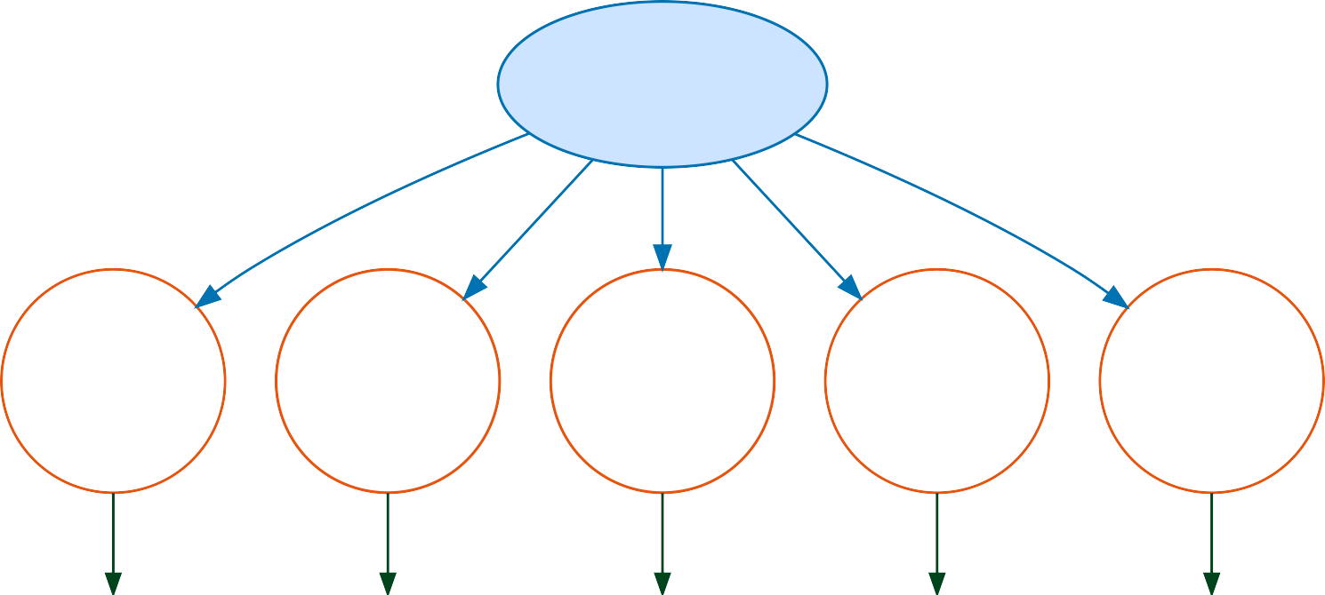
What is a sampling distribution?
A sampling distribution is the distribution of a statistic (such as a mean, median, or correlation) obtained by repeatedly drawing random samples of the same size from the same population and calculating that statistic for each sample.
Population (μ)
Sample 1
Sample 2
Sample 3
Sample 4
Sample R
x̄ ₁
x̄ ₂
x̄ ₃
x̄ ₄
x̄ ᵣ

Slide 26
Demonstration
[sampling distribution demo.r]

Slide 27
A sampling distribution is a theoretical (hypothetical) distribution — we almost never actually observe it in real life.
How many possible samples of 10 countries you can draw from 180 countries?
In practice, we would not (and need not) collect thousands of samples to see what the sampling distribution looks like.
Even though we don’t observe it directly, we can derive its properties mathematically.
This theoretical framework allows us to understand how a statistic (like the sample mean) would behave if we could take all possible samples of the same size from the population.
In reality, we usually have just one sample and one sample mean.
Our goal is to use that single sample mean to make inferences about the population mean.
This kind of inference is only possible because we know what the sampling distribution would look like in theory.

Slide 28
Central Limit Theorem (CLT)
For a population with mean μ and standard deviation σ, the sampling distribution of the sample means, X¯ (from random samples of size n), is approximately normal with
a mean equal to E[X¯] = μ and standard deviation equal to SE(X¯) =
σ
√n
.
As the sample size n increases, this approximation improves regardless of the shape of the population distribution (provided σ² is finite).
If the population is normal, then the sampling distribution of X¯ is exactly normal for any n.
If the population is not normal, we typically need a large enough sample for the sampling distribution of X¯ to be close to normal (how large depends on skewness and extreme values, but larger n helps).

Slide 29
In our demo, we treated 180 countries as our population, and the population mean and astandard deviation for life expectanct was
μ = 71.75
σ = 8.08
If you randomly draw samples of size 10 from this population, what would be the mean and standard deviation of sample means?
If you randomly draw samples of size 30 from this population, what would be the mean and standard deviation of sample means?
If you randomly draw samples of size 50 from this population, what would be the mean and standard deviation of sample means?
If you randomly draw samples of size 100 from this population, what would be the mean and standard deviation of sample means?

Slide 30
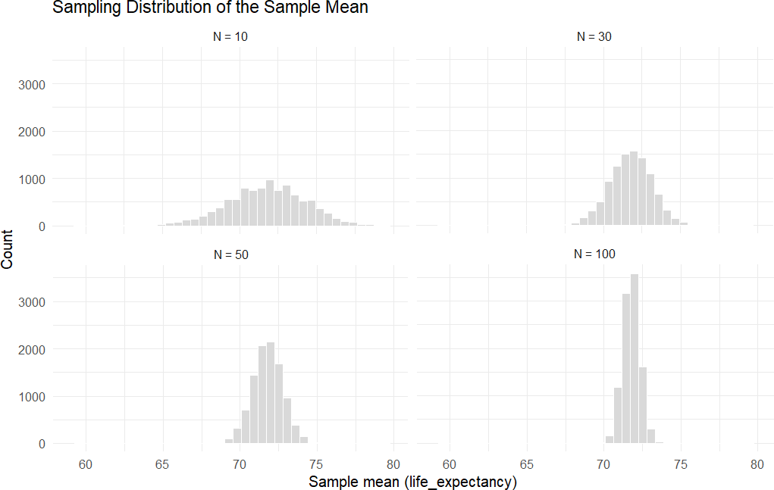

Slide 31
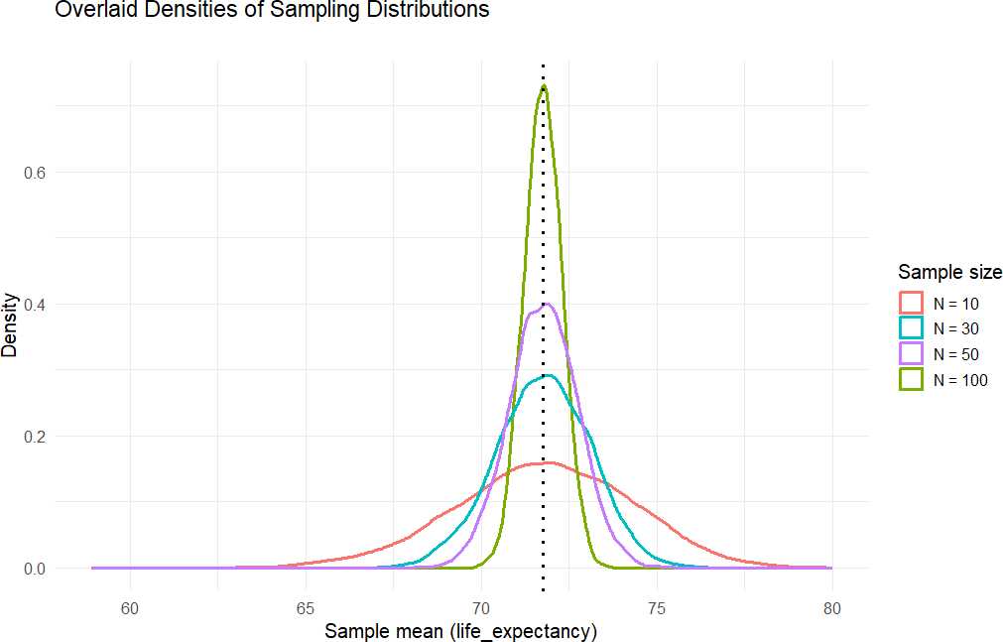

Slide 32
🧩 Practice Question 4
Consider the following population distribution for a variable X.
μ = 0.496
σ = 0.355
If you take a single simple random sample of size 100 from this population and make a histogram of those 100 observed values, what will the sample distribution most likely look like?
3

Slide 33


(A)
(B)
μ = 0.526, σ = 0.351
μ = 0.500, σ = 0.341
33 / 37

Slide 34
🧩 Practice Question 5
Consider again that a variable of interest has the following population distribution.
μ = 0.496
σ = 0.355
If you repeatedly take simple random samples of size n = 100 from this population and compute the sample mean each time, what will the distribution of the sample means look like?
3

Slide 35
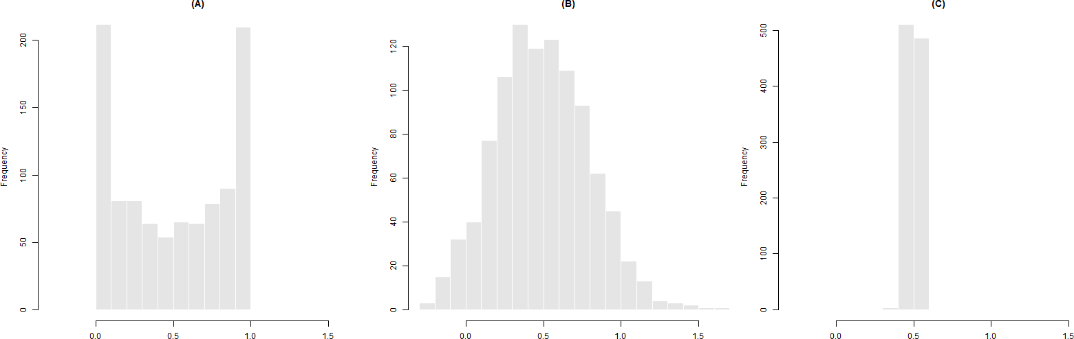
35 / 37

Slide 36
🧩 Practice Question 6
The Institutional Research office at the University of Oregon reports that, for 550 doctoral admits in Fall 2018, the mean GRE Quantitative score was 700 and the standard deviation was 50.
You have the full list of these 550 students and you take a simple random sample of 25 students. Then, you compute the sample mean GRE Quant score for these 25 students.
Question:
What is the probability that the sample mean for these 25 students exceeds 730?
3

Slide 37
🧩 Practice Question 7
The amount of money college students spend per semester on textbooks is normally distributed with mean of $250 and standard deviation of $30. You take a simple random sample of 100 students from this population and compute the sample mean spending for these 100 students.
Question:
What is the probability that the sample mean spending for these 100 students is less than
$245?
3

